Slide 1

Electrical Machinery Fundamentals
EE 250 SPRING 2020
Lecture 8-Chapter 14
1

Slide 2
Chapter 14 Selection and Applications of Three-Phase Induction Machines

Slide 3
14.1 Standardization and classification of induction motors
Standardized dimensions
Machine of one manufacturer can be replaced by the machine of another manufacturer
No change in mounting holes, shaft height or other type of coupling
Standardization includes:
Frame sizes
Electrical, mechanical and thermal characteristics

Slide 4
14.2 Classification according to environment and cooling methods
Motors are grouped into following categories depending upon their operational environment:
Drip-proof motors:
Frame protects windings from liquid drops and solid particles (falling angle ranges from 0 to 15° downward from the vertical)
Cooling by fan directly coupled to the rotor (Cool air drawn and blown over windings and expelled)
Maximum allowable temperature rise may be 60°C, 80°C, 105°C, or 125°C, depending upon the type of insulation used
Can be used in most locations

Slide 5
14.2 Classification according to environment and cooling methods
Splash-proof motors:
Frame protects windings from liquid drops and solid particles (falling angle ranges from 0 to 100° downward from the vertical)
Cooling by fan directly coupled to the rotor (Cool air drawn and blown over windings and expelled)
Maximum allowable temperature rise may be 60°C, 80°C, 105°C, or 125°C, depending upon the type of insulation used
Mostly used in wet locations

Slide 6
14.2 Classification according to environment and cooling methods
Totally enclosed, non-ventilated motors:
Closed frame to prevent free exchange of air
Designed for wet and dusty locations
Rated below 10 kW as heat of larger machines is difficult to remove
Natural convection and radiation for motor heat losses dissipation
Maximum allowable temperature rise may be 65°C, 85°C, 110°C, or 130°C, depending upon the type of insulation used
Designed for wet and dusty locations

Slide 7
14.2 Classification according to environment and cooling methods
Totally enclosed, fan-cooled motors:
Medium and high-power totally enclosed motors are cooled by external blast of air
Cooling by fan directly coupled to the rotor (Cool air drawn and blown over windings and expelled)
Maximum allowable temperature rise may be 60°C, 80°C, 105°C, or 125°C, depending upon the type of insulation used

Slide 8
14.2 Classification according to environment and cooling methods
Explosion-proof motors:
Totally enclosed but not air tight
Frame design to withstand enormous pressure that may build up inside the motor due to explosions
Maximum allowable temperature rise may be 60°C, 80°C, 105°C, or 125°C, depending upon the type of insulation used
Used in highly inflammable or explosive environment like coal mines and oil refineries

Slide 9
14.3 Classification according to electrical and mechanical properties
Motors are grouped into following categories depending upon electrical and mechanical properties:
Motors with standard locked-rotor torque (NEMA Design B):
Per-unit locked-rotor torque decreases with increasing size of motor
It ranges from 1.3 to 0.7 as the power increases from 20 hp to 200 hp
Locked-rotor current should not exceed 6.4 times the rated full-load current
Used to drive fans, centrifugal pumps, machines tools etc.

Slide 10
14.3 Classification according to electrical and mechanical properties
High starting-torque motors (NEMA Design C):
Employed in difficult starting condition
Locked-rotor current should not exceed 6.4 times the rated full-load current
In general motors are equipped with double-cage rotor whose excellent performance is due to following facts:
Frequency of rotor current diminishes as motor speeds up
Conductors of cage 1 (outer) are much smaller than that of cage 2 (inner)
Conductor close to rotor surface has lower inductive reactance than that of buried deep inside the iron core
Develops high starting torque and low slip at full-load
Not recommended for starting high-inertial loads because most of I²R losses during start-up are concentrated in cage 1 and due to small size, it tends to over heat and bars may melt
Application: Pumps and piston type compressors that have to start under load

Slide 11
14.3 Classification according to electrical and mechanical properties
High-slip motors (NEMA Design D):
Rated speed lies between 85% and 95% of synchronous speed
High-resistance squirrel-cage rotor is made of brass
Example: Punching holes (Impact energy delivery by flywheel)
Application: Used to accelerate high-inertial loads

Slide 12
14.3 Classification according to electrical and mechanical properties

Slide 13
14.4 Choice of motor speed
Motor speed selection is limited as synchronous speed of motor changes with frequency and number of poles (=120f/p)
For low-speed load machines it is preferable to use high-speed motor with gearbox instead of low-speed motor
Following are the advantages of using gearbox:
For a given output power, size and cost of high-speed motor is less than of low speed-motor and efficiency and power factor are also higher for high-speed motors.
High locked-rotor torque for high-speed motor than that of low-speed motor of same specifications.

Slide 14
14.5 Two speed motors
Stator can be designed in such a way that motor can be operated at two different speed
Following are the methods for special designing of stator:
1. Wind the stator with two separate windings having different poles, say, 4 and 6
Problem: Only one winding is operational at a time so half of the copper is utilized
2. Special stator windings in which speed is changed by changing external stator connections
Synchronous speed obtained are usually in the ratio 2:1 (3600/1800 rpm)
Poles and synchronous speed have inverse relation n_{s}=120f/p
Low speed is produced by creating consequent poles

Slide 15
14.5 Two speed motors

Slide 16
14.6 Induction motor characteristics under various load conditions
Most of the time motor runs close to synchronous speed supplying torque that varies form zero to full-load torque T_{N}
Between these limits torque-speed curve is essentially straight line
Slope of line depends upon rotor resistance, lower the resistance => steeper the slope
At rated frequency, slip, torque, line voltage and resistance are related as:
k= constant depending upon motor construction

Slide 17
14.6 Induction motor characteristics under various load conditions
This shows how line voltage and rotor resistance effect the behavior of motor under load
By knowing characteristics of motor for a given condition, we can predict speed, torque, power etc. for any other load condition

Slide 18
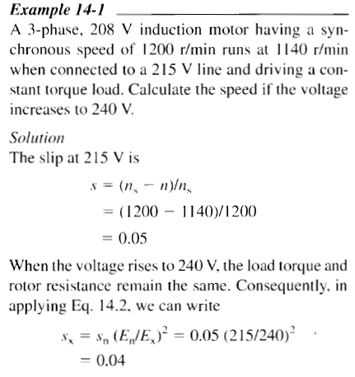
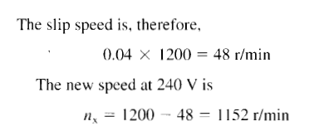
14.6 Induction motor characteristics under various load conditions

Slide 19
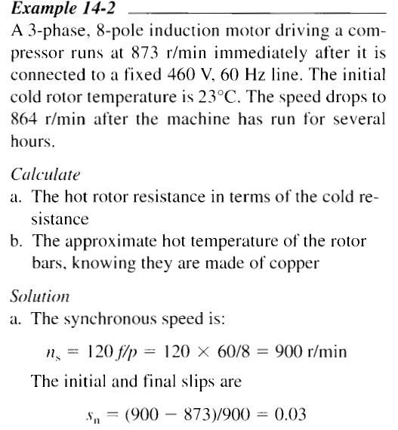
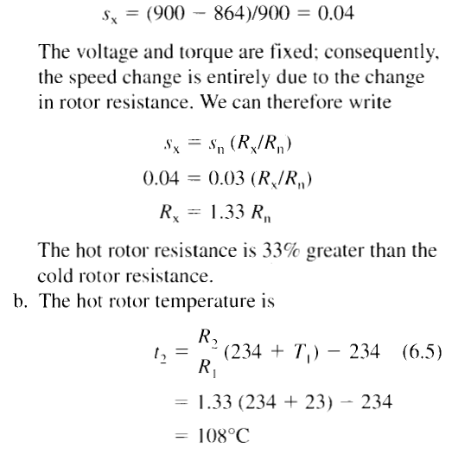
14.6 Induction motor characteristics under various load conditions

Slide 20
14.6 Induction motor characteristics under various load conditions

Slide 21
14.7 Starting an induction motor
Due to prolong the starting period high-inertial loads put strain on induction motors
Overheating is major problem during start up interval due to high starting current in stator and rotor
Large powered machines may overload the line that may effect other loads connected to line
Solution: Inductions motors to start at reduced voltages
This limits the power drawn by the motor
Reduced line voltage drops
Reduced heating rate of winding
Lengthens starting time of machine (usually not much important)
Regardless of the starting time, following rule is important for the motor that is not loaded mechanically
Rule 1: Heat dissipated in rotor during starting period is equal to the final K.E stored in all revolving parts
Example: Motor used to run flywheel => Energy stored in flywheel say 200 joules => Rotor will have dissipated 200 joules of energy in the form of heat

Slide 22
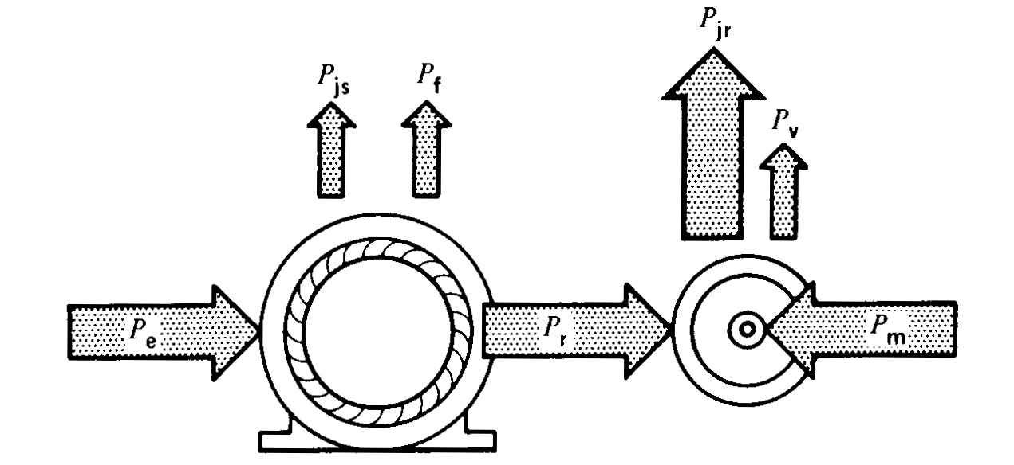
14.8 Plugging an induction motor
For bringing induction motor and load to quick stop
By interchanging two stator leads that will produce revolving field in opposite direction to that of rotor
Motor acts as brake during plugging period
Absorbs kinetic energy from revolving load and results in falling the speed of machine
Associated mechanical power P_{M} is entirely dissipated as heat in the rotor
Rotor continually receives power P_{r} from stator that is also dissipated as heat
So, plugging produces I²R losses in rotor which are even more than that of locked rotor condition
So, motor should not be plugged too frequently and for long interval because it may rise rotor temperature that may result in melting of rotor bars
Following rule must be kept in mind for plugging operation:
Rule 2: Heat dissipated in rotor during plugging period is three times the original K.E of all revolving parts

Slide 23
14.9 Braking with direct current
Induction machines can be brought to quick stop by circulating DC current in stator
Connect any two leads with DC source
DC source will setup stationary poles N & S
Number of created poles will be equal to poles that motor generates normally
AC voltage is induced in rotor bars when rotor swept across the stationary field
Induced AC voltage produces AC current in the rotor
I²R losses are dissipated at the expense of kinetic energy stored in revolving parts
Motion comes to rest when all K.E dissipated as heat in rotor
Advantage: Far less heat production than that of plugging
(Energy dissipated in the rotor in the form of heat only comes from K.E of revolving parts)
Energy dissipation in the rotor is independent of magnitude of DC current
Magnitude of DC current only varies the braking time
Smaller current => Large braking time , Large current => Less braking time
DC current can be 2 or 3 times the rated current of motor
Larger values to be used by ensuring that stator should not become too hot
Braking torque is proportional to the square of DC braking current

Slide 24
Abnormal Conditions
Internal problems (short circuit in stator, overheating of bearings)
&
External Problems
Mechanical overload
Line voltage changes
Single-phasing
Frequency variation
Voltage change +/- 10%
Frequency Change +/- 5%

Slide 25
Abnormal Conditions
14.11 Mechanical overload
Can be run twice of rated power for short time,
Overload cause over-heating, which may burn insulation, reduce service life
Overload causes thermal overload relays in the starter box to trip
Drip proof can be run at 15% overload, overload capacity is shown on the nameplate as service factor
In emergency it can carry overload as much as 125% with supplementary external ventilation.
14.12 Line voltage changes
Voltage Decrease (Torque speed curve changes)
Voltage increase (more flux per pole than normal, iron and magnetizing losses increase, power factor reduced )
3 Phase voltage unbalance

Slide 26
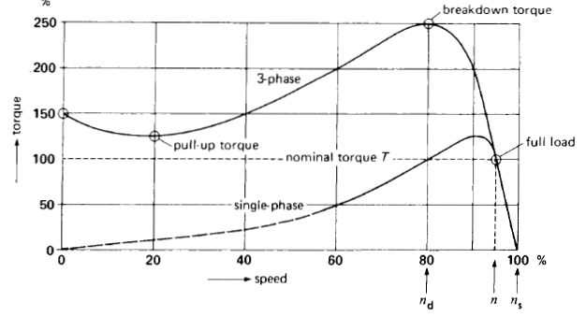
Abnormal Conditions
14.13 Single-phasing
If one phase get damaged, two phases will carry double currents, motor will overheat
Thermal relays will trip
14.14 Frequency variation
Induced voltage and current varies.

Slide 27
14.15 Induction motor operating as a generator
Example 1: Electric train powered by squirrel-cage induction motor
Moving up hill => n_{s} > n (Developing torque to overcome rail friction and gravity)
Moving on ground of hill => n_{s} ~ n (Developing torque to overcome rail friction only as gravity does not vary)
Moving down hill => n_{s} < n
When n_{s} < n following happens:
Counter torque developed by motor that opposes increase in speed
This counter torque has same effect as that of brake but instead of dissipation as a heat the braking mechanical power is fed to line in the from of electrical energy and this system acts a generator
Such a machines that runs faster than n_{s} and converts mechanical power to electrical and supplies to line is called asynchronous generator
Example 2: In cranes, during lowering cycle motor receives power from mechanical load and fed it to line

Slide 28
14.15 Induction motor operating as a generator
Example 3: Asynchronous generator can also be formed by connecting ordinary squirrel-cage motor to 3-phase supply and coupling it to a gasoline engine
Motor becomes generator when engine speed exceeds the synchronous speed
For creating magnetic field motor continues to absorb reactive power Q from line that flow opposite to active power P being supplied to line
P delivered to line is directly proportional to slip above synchronous speed
Greater the engine speed => greater the electrical output
Q may be supplied by group of capacitor which eliminates the need of external 3-phase source
Generated frequency is slightly less than that corresponding to the speed of rotation
Terminal voltage of generator:
Increases with increased capacitance
Magnitude is limited by the saturation of iron
Insufficient capacitance => Generator voltage will not build up
Capacitor bank must supply at least as much reactive power as supplied by line when machine act as generator

Slide 29
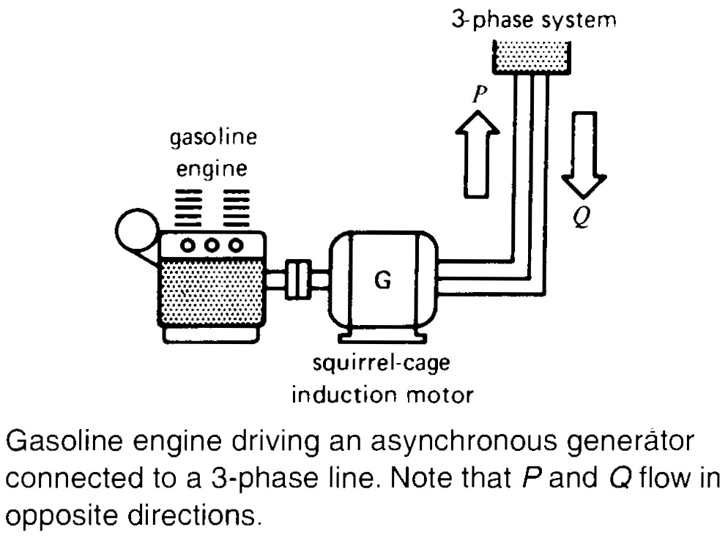
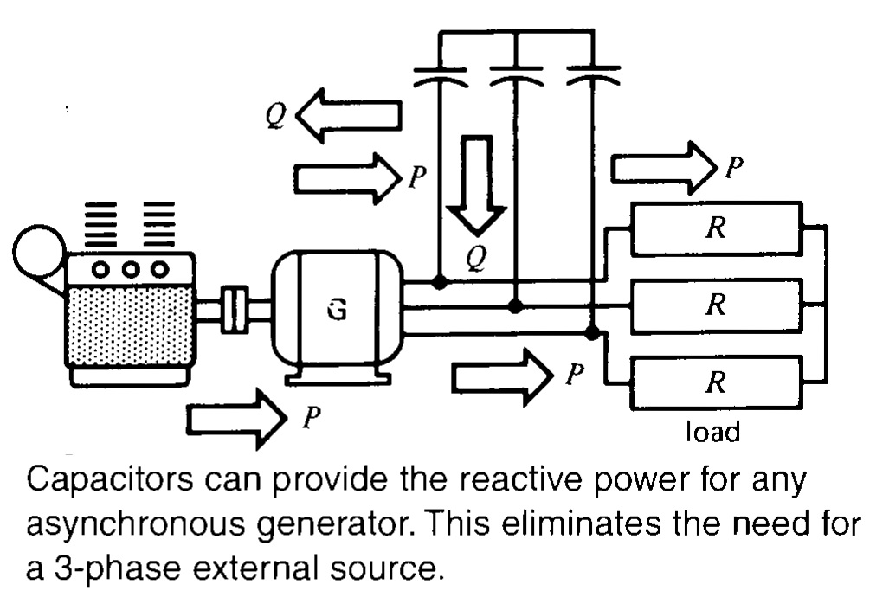
14.15 Induction motor operating as a generator

Slide 30
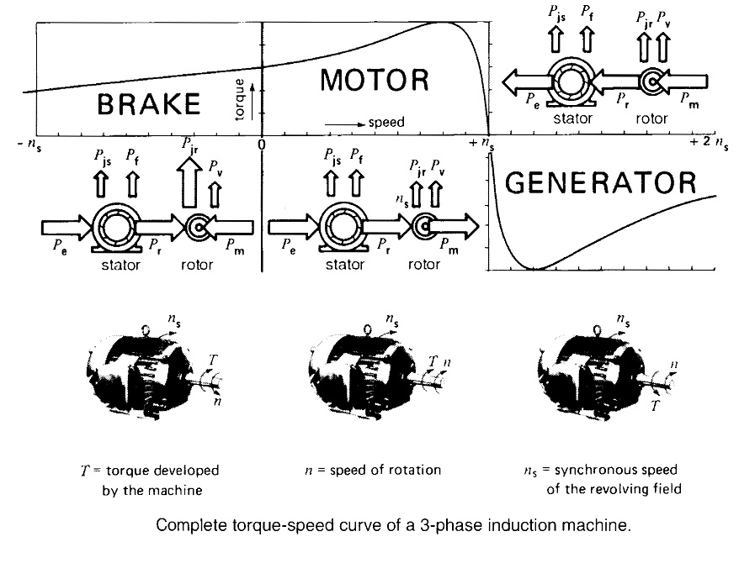
14.16 Complete torque-speed characteristic of an induction motor
For squirrel-cage induction machine three modes (motor, generator and brake) of operation are merged and shown as follows:
For motor and generator operation:
Shaft turn in same direction as that of revolving magnetic field
For motor n_{s} > n
For generator n_{s} < n
For brake rotor rotates in opposite direction to that of revolving field

Slide 31
14.17 Features of wound-rotor induction motor
Squirrel-cage induction motor is most commonly used in industrial applications
Wound-rotor induction motor has certain features that make it attractive in special industrial applications
Features may be listed as follows:
14.18 Start-up of very high-inertia loads
14.19 Variable-speed drives
14.20 Frequency converter

Slide 32
14.18 Start-up of very high-inertia loads
When load is brought up to speed with induction motor, energy dissipated in rotor is equal to K.E imparted to load
This shows heavy inertial loads (large K.E) will result in large amount of heat dissipation at rotor causing it to become very hot
Advantage of wound-rotor:
Heat dissipation in external resistor connected to motor via slip-ring => Motor itself remains cool
External resistor can be varied as the motor speeds up => It becomes possible for motor to develop maximum torque during entire acceleration period
Final speed can be reached in smallest shortest time

Slide 33
14.19 Variable-speed drive
Increase in rotor resistance will result in falling of rotor speed
So, we can achieve any speed by varying external rotor resistance of wound-rotor induction machine
Problem: Power dissipation in resistor makes it inefficient system that becomes costly when machine rating is very high
Solution: Connect slip-rings to electronic converter
Converter changes the power at low rotor frequency to power at line frequency and feeds this power back into 3-phase system => Variable speed control system becomes efficient

Slide 34
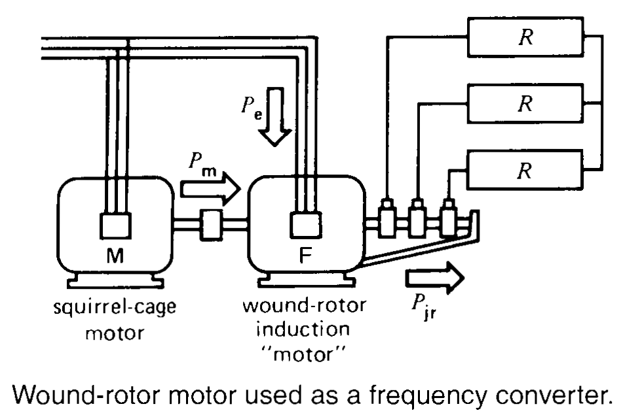
14.20 Frequency converter
Wound-rotor motor can be used as frequency converter that generates frequency different from utility company
Construction and working:
Stator is connected to line
Rotor is driven by motor M
Rotor supplies power to 3-phase load at voltage E₂ and frequency f₂
E₂ and f₂ both depends upon slip
Desired frequency is 2 or 3 times the frequency of line => Slip must be positive and greater than 1 => Shaft must be rotated against the direction of revolving field

Slide 35
Summary
Topics: 14.1-14.20
Examples:14.1-14.7

